Slide 1
Feature 1: Presentation
Members:
LanNH7, QuanVM4

Slide 2
Feature 1
Install tools (Docker, Python, Terraform) and hosting Localstack
AWS and AWS serverless
Applications in AWS
Small practice

Slide 3
Install tools (Docker, Python, Terraform) and hosting Localstack
Step 1: Install Docker Desktop for window (version 20.10.13). Link: https://docs.docker.com/desktop/windows/install/
Step 2: Install Python through Visual Code or download python directly (version 3.9.7).
Link: https://www.python.org/downloads/
Step 3: Download Terraform and set up in environment variables (version 1.1.8). Link: https://www.terraform.io/downloads

Slide 4
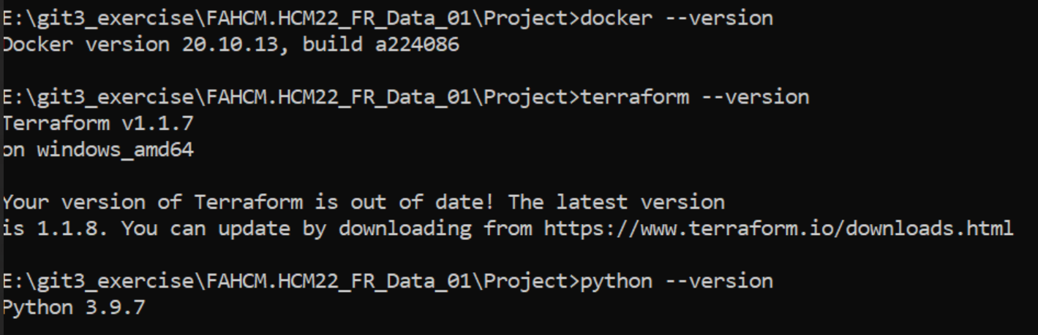
Result

Slide 5
Why installing Docker, Terraform, Python, hosting Localstack?
Programming language in feature 1: Python
Docker and Docker-compose are one of ways to hosting Localstack through container
Localstack is a testing/mocking framework for developing Cloud applications locally. Where in theory, you can stick any AWS service and emulate them in localhost without ever needing the real AWS account.
Terraform is used to build, deploy infrastructure of AWS as code after hosting localstack.

Slide 6
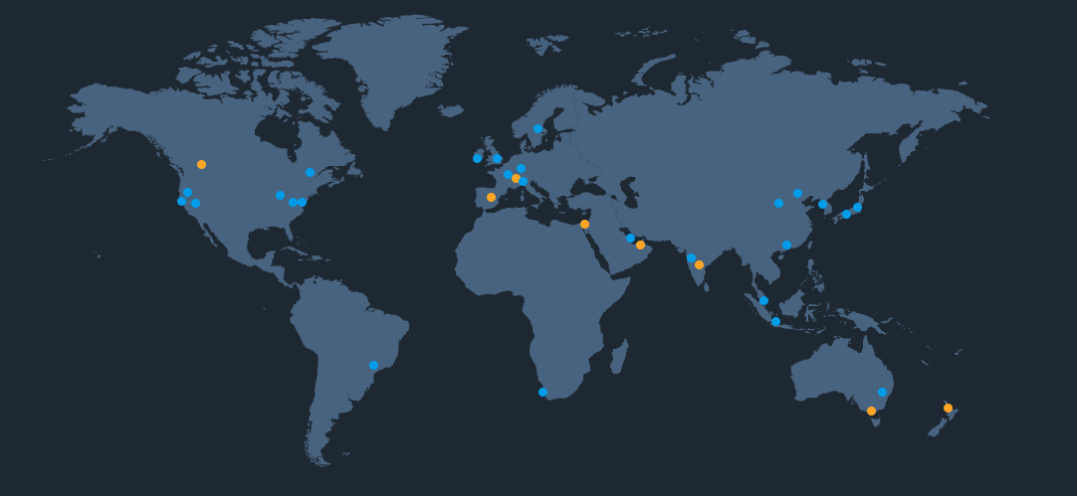
2. AWS and AWS serverless
Amazon Web Services (AWS): is the world's most comprehensive and broadly adopted cloud platform, offering over 200 fully featured services from data centers globally.
Several applications than any cloud companies
Large customer community.
The most security
The fast speed of innovation
The best operation
The global AWS networks

Slide 7
AWS serverless
Definition: AWS serverless is the technology so as to run code, manage data, and integrate applications without server
Advantage: automatic scalability, optimizing cost, flexibility
AWS serverless services: AWS Lambda, Amazon API gateway, Amazon S3, Amazon Dynamodb,…

Slide 8

3. Applications in AWS - AWS Lambda
AWS Lambda is an event-driven, serverless computing platform provided by Amazon as a part of Amazon Web Services.
It is a computing service that runs code in response to events and automatically manages the computing resources required by that code.
Lambda runs code on a high-availability compute infrastructure and performs all of the administration of the compute resources, including server and operating system maintenance, capacity provisioning and automatic scaling, code monitoring and logging
Lambda function is a place to organize codes. Lambda function can be invoked throughout lambda API or run in response to events from other AWS services.
AWS Lambda natively supports Java, Go, PowerShell, Node. js, C#, Python, and Ruby code

Slide 9
3. Applications in AWS - AWS Lambda
Easy pricing
Integrated with the whole AWS suite of services.
Easy monitoring through AWS Cloudwatch.
Easy to get more resources per functions (up to 10GB of RAM)
Increasing RAM will also improve CPU and network
Memory allocation: 128 MB – 10 GB (1 MB increment) - depending on regions
Maximum execution time: 900 seconds (15 minutes)

Slide 10
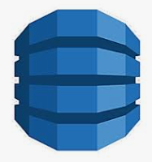
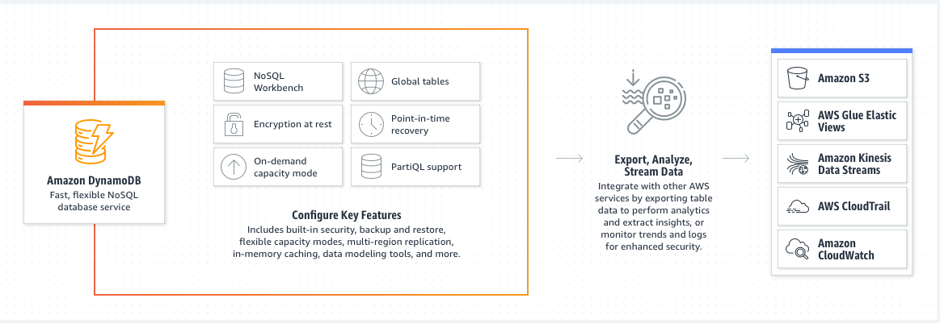
3. Applications in AWS – Amazon DynamoDB
Amazon DynamoDB is a fully managed proprietary NoSQL database service that supports key–value and document data structures. DynamoDBb just only create table
Millions of requests per seconds, trillions of row, 100s of TB of storage

Slide 11
3. Applications in AWS – Amazon DynamoDB
Data types: Scalar types (string, number, binary, boolean, null), document types (lists, map), set types (string set, number set, binary, set).
Each table has a primary key
Each table can have an infinite number of items (rows)
Each item has attributes (can be added over time – can be null)
Maximum size of an item is 400kb (not good for large data)
Items are automatically deleted after an expiry timestamp (a process)

Slide 12
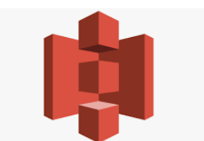
3. Applications in AWS - AWS Simple Cloud Storage (S3)
Amazon S3 is an object storage service that stores data as objects within buckets. An object is a file and any metadata that describes the file. A bucket is a container for objects.
Amazon S3 provides strong read-after-write consistency for PUT and DELETE requests of objects in your Amazon S3 bucket in all AWS Regions
S3 offers industry-leading scalability, data availability, security, and performance.
Amazon S3 provides management features so that you can optimize, organize, and configure access to data to meet specific business, organizational, and compliance requirements.
Maximum object size is 5TB (5000Gb)

Slide 13
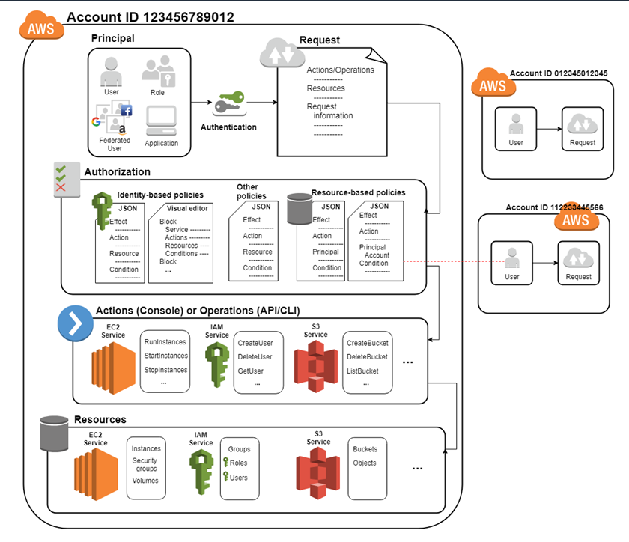
3. Applications in AWS - IAM role
AWS Identity and Access Management (IAM) is a web service that helps to securely control access to AWS resources. IAM is used to control who is authenticated (signed in) and authorized (has permissions) to use resources.

Slide 14
Small practicce

Slide 15
Thank you for listening!

